Slide 1
Workshop 4
Advanced Analytics and Applications [AAA]
Information Systems for Sustainable Society (is3) | WiSo Faculty | Univ.-Prof. Dr. Wolfgang Ketter | 5/4/21

Slide 2
I
Multiple Choice Questions
II
Expectation Maximization Algorithm
III
Programming

Slide 3
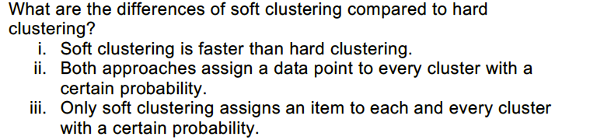
AAA Workshop
Question 1.1: Soft vs. Hard Clustering

Slide 4
AAA Workshop
Question 1.1: Soft vs. Hard Clustering

Slide 5
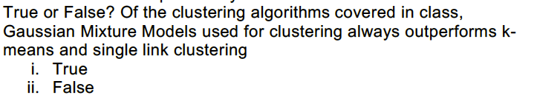
AAA Workshop
Question 1.2: True or False? GMM superb?

Slide 6
AAA Workshop
Question 1.2: True or False? GMM superb?

Slide 7
I
Multiple Choice Questions
II
Expectation Maximization Algorithm
III
Programming

Slide 8
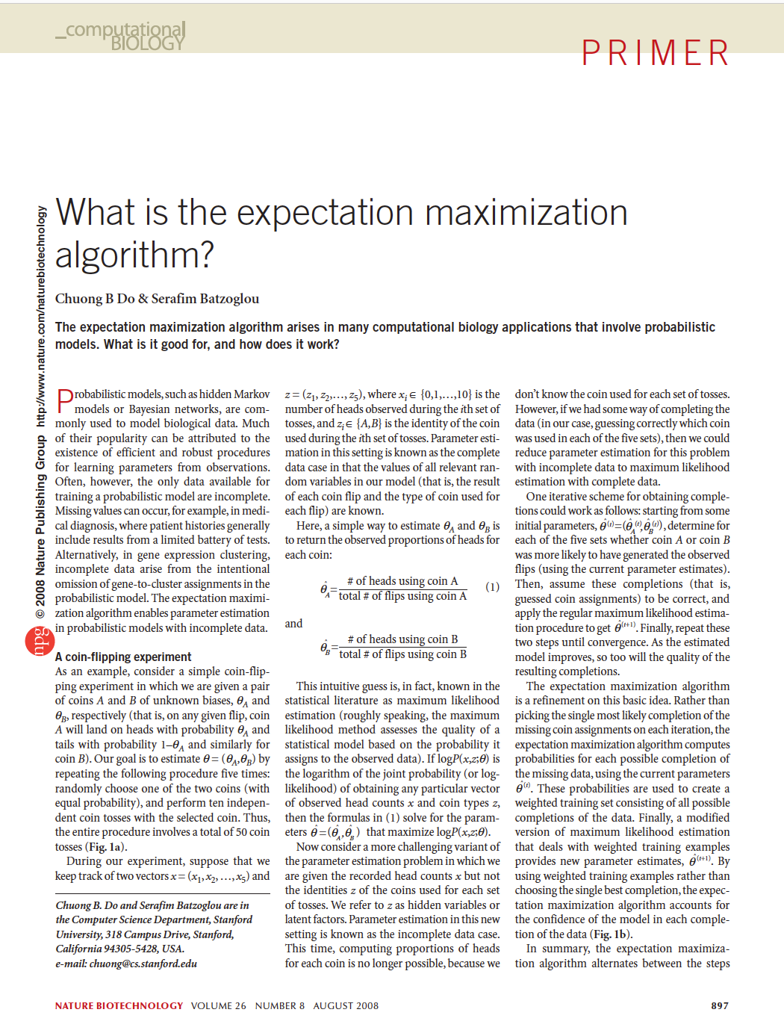
AAA Workshop
Question 2.1: Expectation Maximization
Read the paper.

Slide 9
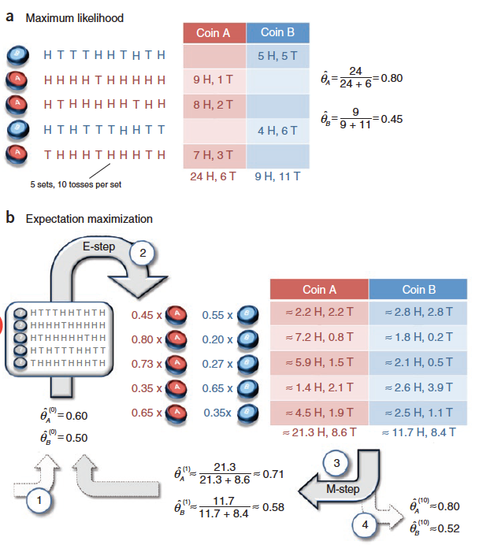
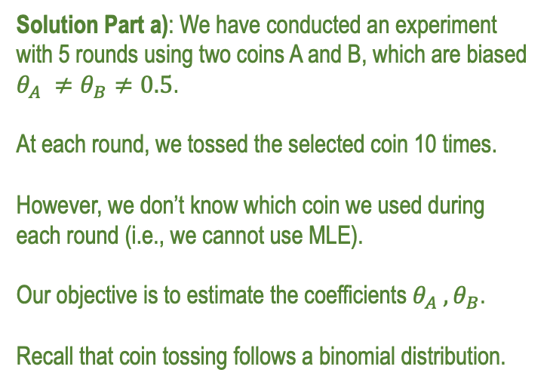
AAA Workshop
Question 2.2: Expectation Maximization
Explain the application of the EM algorithm in light of the coin toss experiment.
Solution Part a): We have conducted an experiment with 5 rounds using two coins A and B, which are biased $θ_{A} ≠θ_{B}≠0.5$. At each round, we tossed the selected coin 10 times.
However, we don’t know which coin we used during each round (i.e., we cannot use MLE). Our objective is to estimate the coefficients $θ_{A} , θ_{B}$. Recall that coin tossing follows a binomial distribution.
?

Slide 10
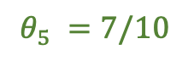
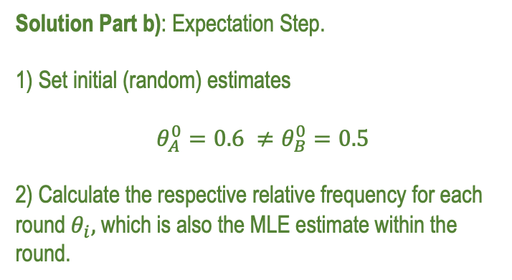
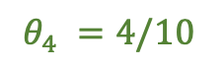
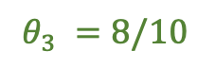
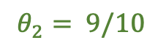
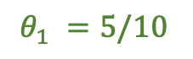
AAA Workshop
Question 2.2: Expectation Maximization
We solve the problem using EM.
Solution Part b): Expectation Step. 1) Set initial (random) estimates $θ_{A}^{0}=0.6 ≠θ_{B}^{0}=0.5$
2) Calculate the respective relative frequency for each round $θ_{i},$which is also the MLE estimate within the round.
$$θ_{1} =5/10$$
$$θ_{2}= 9/10$$
$$θ_{3} =8/10$$
$$θ_{4} =4/10$$
$$θ_{5} =7/10$$

Slide 11
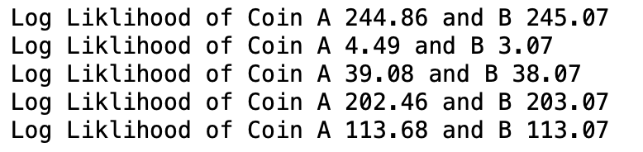

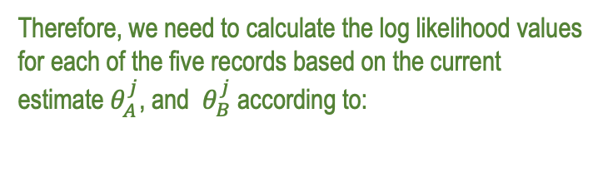
AAA Workshop
Question 2.2: Expectation Maximization
We solve the problem using EM.
Solution Part c): Calculate the weights, or in other words, the probability how likely a record is drawn from either coin A or coin B.
Therefore, we need to calculate the log likelihood values for each of the five records based on the current estimate $θ_{A}^{j}$, and $θ_{B}^{j}$ according to:

Slide 12
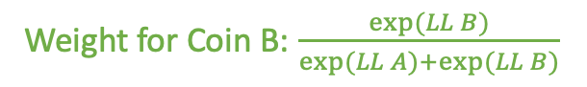
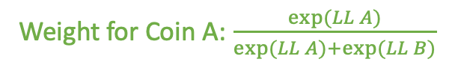
AAA Workshop
Question 2.2: Expectation Maximization
We solve the problem using EM.
Solution Part d): Based on these log liklihoods, we then calculate the weights for each round as follows:
Weight for Coin A: $\frac{exp⁡(LL A)}{exp⁡(LL A)+exp⁡(LL B)}$
Weight for Coin B: $\frac{exp⁡(LL B)}{exp⁡(LL A)+exp⁡(LL B)}$

Slide 13
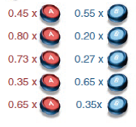
AAA Workshop
Question 2.2: Expectation Maximization
We solve the problem using EM.
Solution Part d): Based on these log liklihoods, we then calculate the weights for each round as follows:
Weight for Coin A: $\frac{exp⁡(LL A)}{exp⁡(LL A)+exp⁡(LL B)}$
Weight for Coin B: $\frac{exp⁡(LL B)}{exp⁡(LL A)+exp⁡(LL B)}$

Slide 14

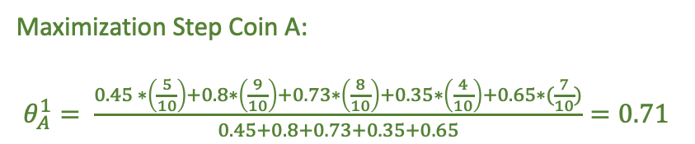
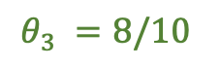
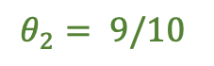

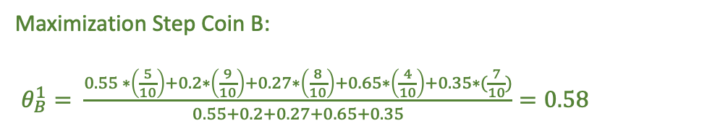
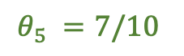
AAA Workshop
Question 2.2: Expectation Maximization
We solve the problem using EM.
Solution Part d): Maximization Step:
Maximization Step Coin A: $θ_{A}^{1}= \frac{0.45 ∗\left(\frac{5}{10}\right)+0.8∗\left(\frac{9}{10}\right)+0.73∗\left(\frac{8}{10}\right)+0.35∗\left(\frac{4}{10}\right)+0.65∗(\frac{7}{10})}{0.45+0.8+0.73+0.35+0.65}=0.71$
Maximization Step Coin B: $θ_{B}^{1}= \frac{0.55 ∗\left(\frac{5}{10}\right)+0.2∗\left(\frac{9}{10}\right)+0.27∗\left(\frac{8}{10}\right)+0.65∗\left(\frac{4}{10}\right)+0.35∗(\frac{7}{10})}{0.55+0.2+0.27+0.65+0.35}=0.58$
$$θ_{1} =5/10$$
$$θ_{2}= 9/10$$
$$θ_{3} =8/10$$
$$θ_{4} =4/10$$
Then, repeat expectation and maximization step until convergence.
$$θ_{5} =7/10$$

Slide 15
AAA Workshop
Question 2.3: Expectation Maximization
Explain the difference between maximum likelihood estimation and EM approaches based on the coin toss example.
Solution: Maximum Likelihood Approach requires full information on the group assignment of each coin. EM doesn‘t require these information but tries to learn it from the data. ML finds global optimum, EM splits the problem into sub problems and find for these sub problems global optima. After that it combines the solutions of each sub problem, which in turn might end up in local optima of the overarching problem.

Slide 16
I
Multiple Choice Questions
II
Expectation Maximization Algorithm
III
Programming

Slide 17
Contact
For general questions and enquiries on research, teaching, job openings and new projects refer to our website at www.is3.uni-koeln.de
For specific enquiries regarding this course contact us by sending an email to the IS3 teaching address at is3-teaching@wiso.uni-koeln.de

